Slide 1
AI-Sokoban FPGA Project
By:
Chiao Lu 204848946
Yuhai Li 104844760
Shen Teng 104758168

Slide 2
Project Introduction
Our iRobot will intelligently calculate an optimal path to push a box to a destination while avoiding obstacles (sensed by camera).
This project is interesting because we combined multiple FPGA hardwares (iRobot, camera) and AI algorithm into a working design.
The purpose is to help automate the process of moving objects from one place to another in a room. For example, our project can help warehouse managers to improve their work efficiency.
We are developing: iRobot control, camera control, object/color recognition, and AI-based path generator.

Slide 3
Real-World Constraints
Robot can not move up/downstairs, poor calibration, cannot push heavy objects, poor camera quality, and grid-based path
Cost: iRobot, FPGA board, camera, and electricity cost.
Should be easy to manufacture. Just need board, camera, robot, and code.
Safety constraint: should not bump into human, need a safety switch.
Real world example. For example we want to use the robot in a warehouse to help moving boxes around. First we need to make sure the robot does not run into humans or restricted zones. Also, we need to make sure even if it does, the harm that is caused by the robot is minimal .

Slide 4
Industry Standards
Serial cable for FGPA board and iRobot communication
HDMI for monitor and FPGA board communication
VHDCI (Very High Density Cable Interconnect) connector for camera and board communication
10 bit color depth, 680x480 resolution

Slide 5
Costs
Costs: FPGA board, camera, HDMI monitor (optional), iRobot, and electricity cost.
Marketing cost: buy/print posters, money to hire sales, tax, warranty, and shipping cost.
Human cost: need to hire developers and technicians

Slide 6
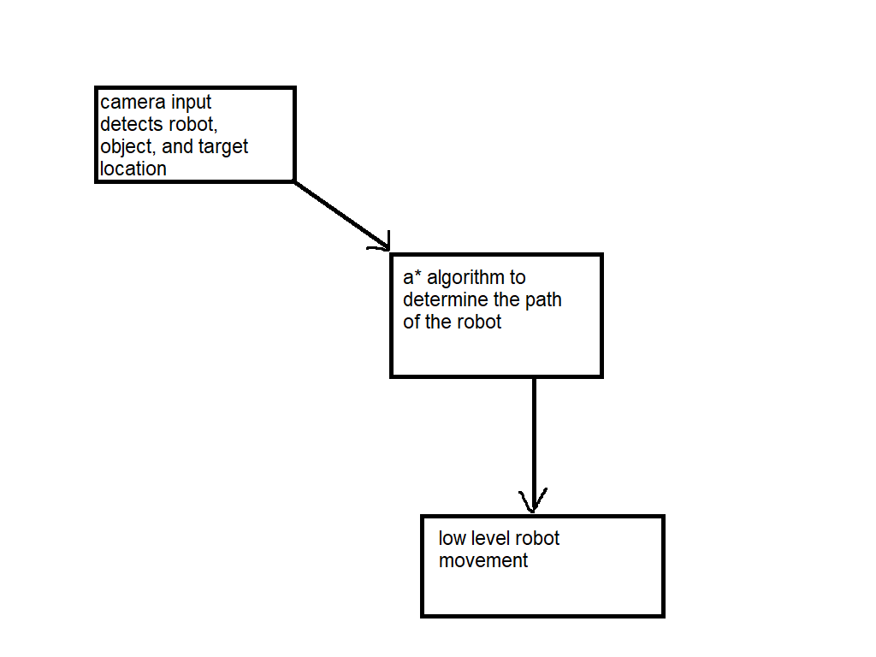
Project Description

Slide 7
Project Description
First, we use camera to determine the locations of the robot, obstacles (walls), box to push, and destination
The FPGA receives these information and generates a path for the robot (using A* algorithm)
The FPGA then converts the paths into low level individual commands then sends them to the Robot

Slide 8
Algorithm (Path Finding)
A*:
States: a matrix containing the positions of walls, robot, box and goal.
Actions: move up, down, left and right
Cost: steps taken
Heuristics: Manhattan Distance from box to goal
The node with lowest cost+heuristic value will be expanded first.

Slide 9
Algorithm (Video)
First, split the data for each pixel into red, blue, and green; each color 4 bits long.
Scan the whole frame
For each pixel, determine whether it’s white, black, red, blue, or green using threshold that we observed from the data.
Turn entire frame into 4x4 2d array.
The color of each cell is determined by the dominant color

Slide 10
Algorithm (robot)
Initialize the robot and set baud rate
Put the robot into full mode
Set a initial facing direction (defaults to RIGHT)
Upon receiving a movement direction, first sleep for 2 seconds, then make the robot start moving, and use the built in sensor to terminate the movement when the requested move has been completed.
Need to calculate radius, velocity, and stop condition. Also need a lot of calibration.

Slide 11
Hardware
Camera
Access directly through memory-mapped IO
iRobot
Using serial IO with special command sendbyte
HDMI monitor
Same memory as camera

Slide 12
Software
Microblaze C++ platform
Video algorithm and HDMI output. Read and write directly to memory
Call APIs to send/receive information through serial line

Slide 13
Demo
https://drive.google.com/file/d/1jb_n-vmK--PtI9ChC39C4J7icH0t5Do2/view
https://drive.google.com/file/d/1yNWeFa_LRhkmNOYlrPj3Nwmye-18NmgM/view?usp=sharing

Slide 14
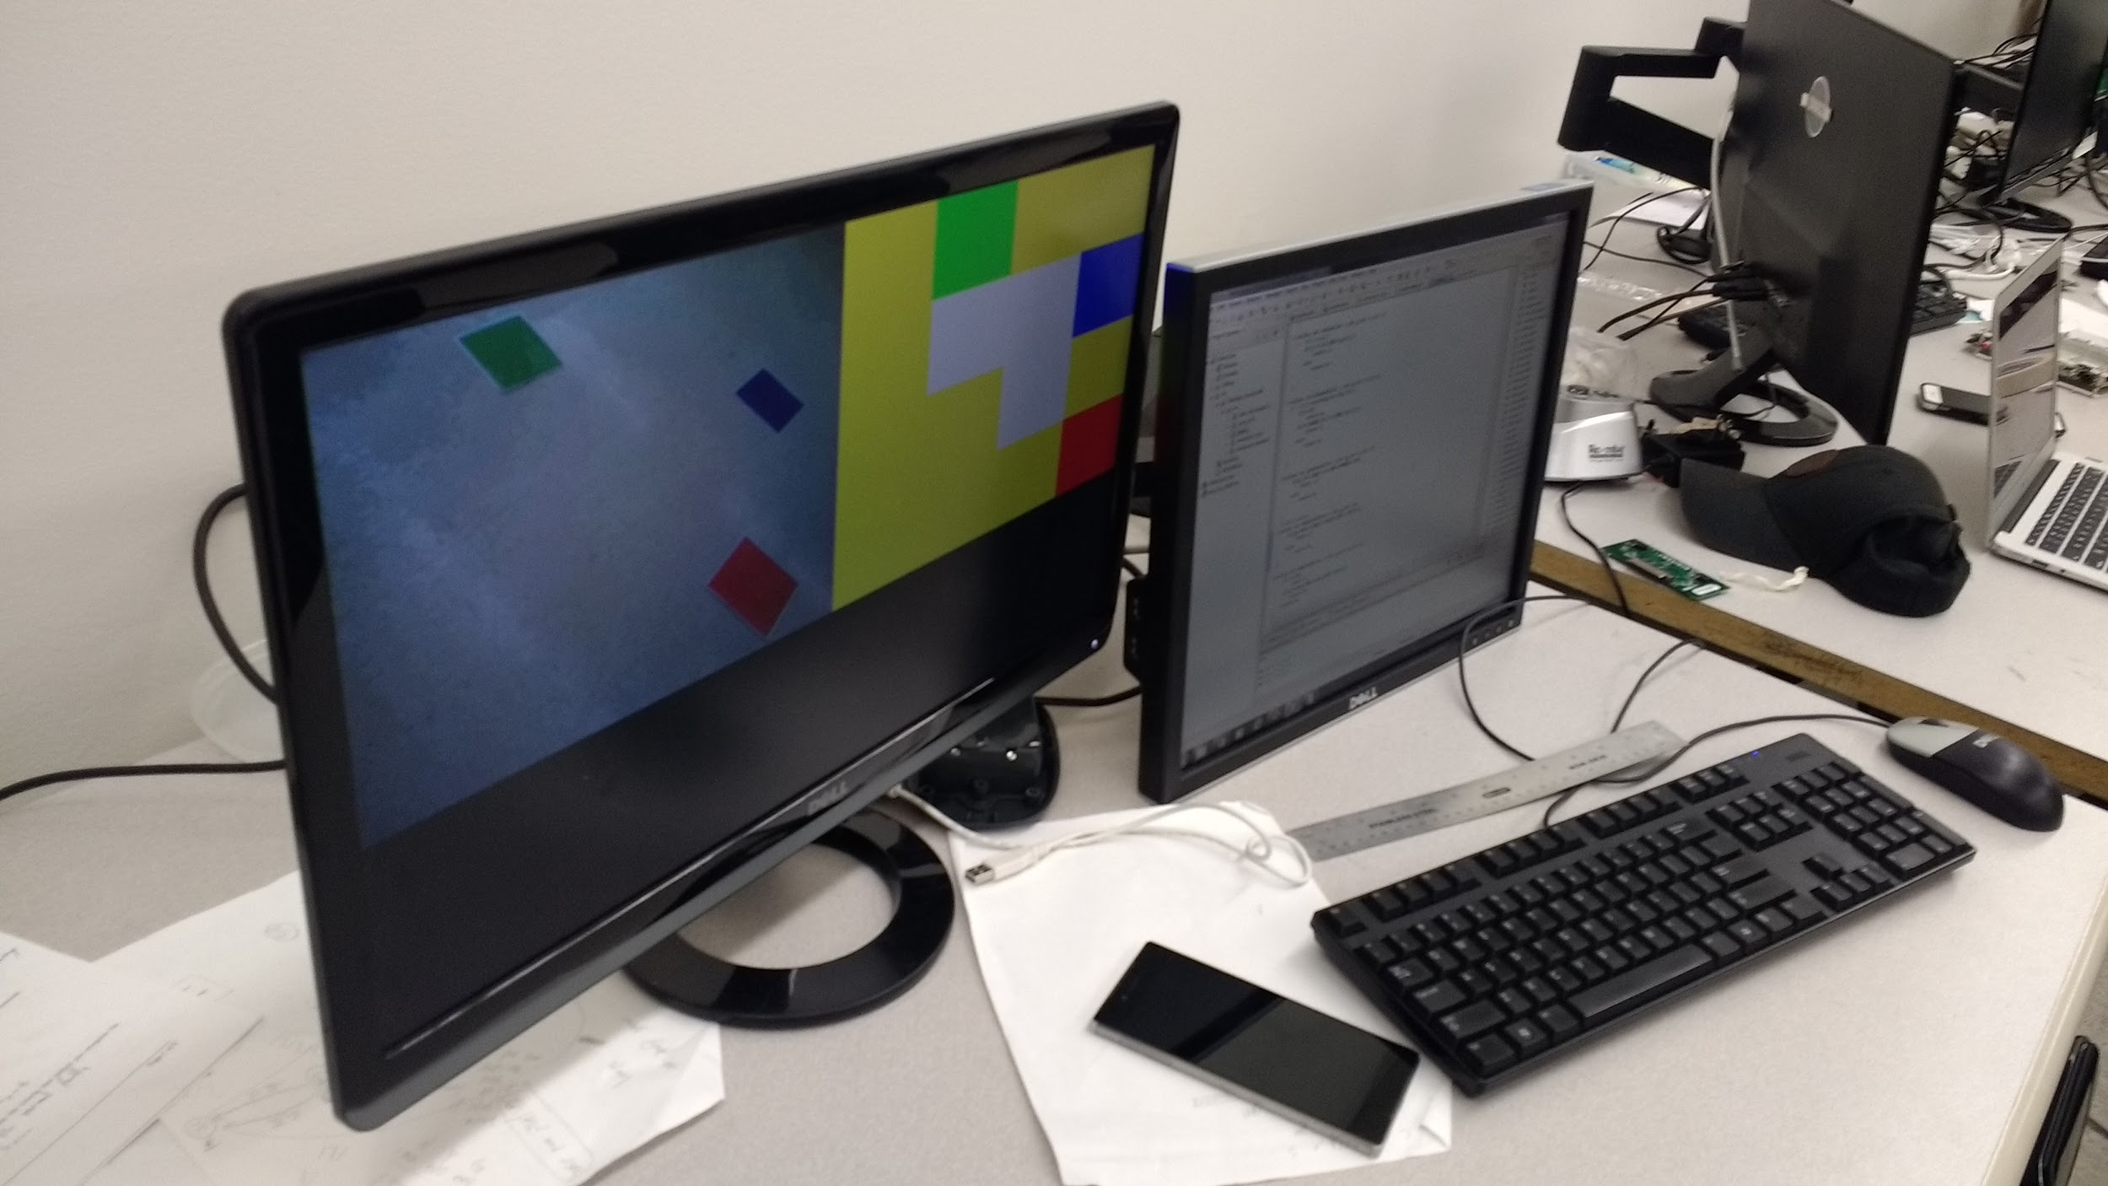
Demo (screen)

Slide 15
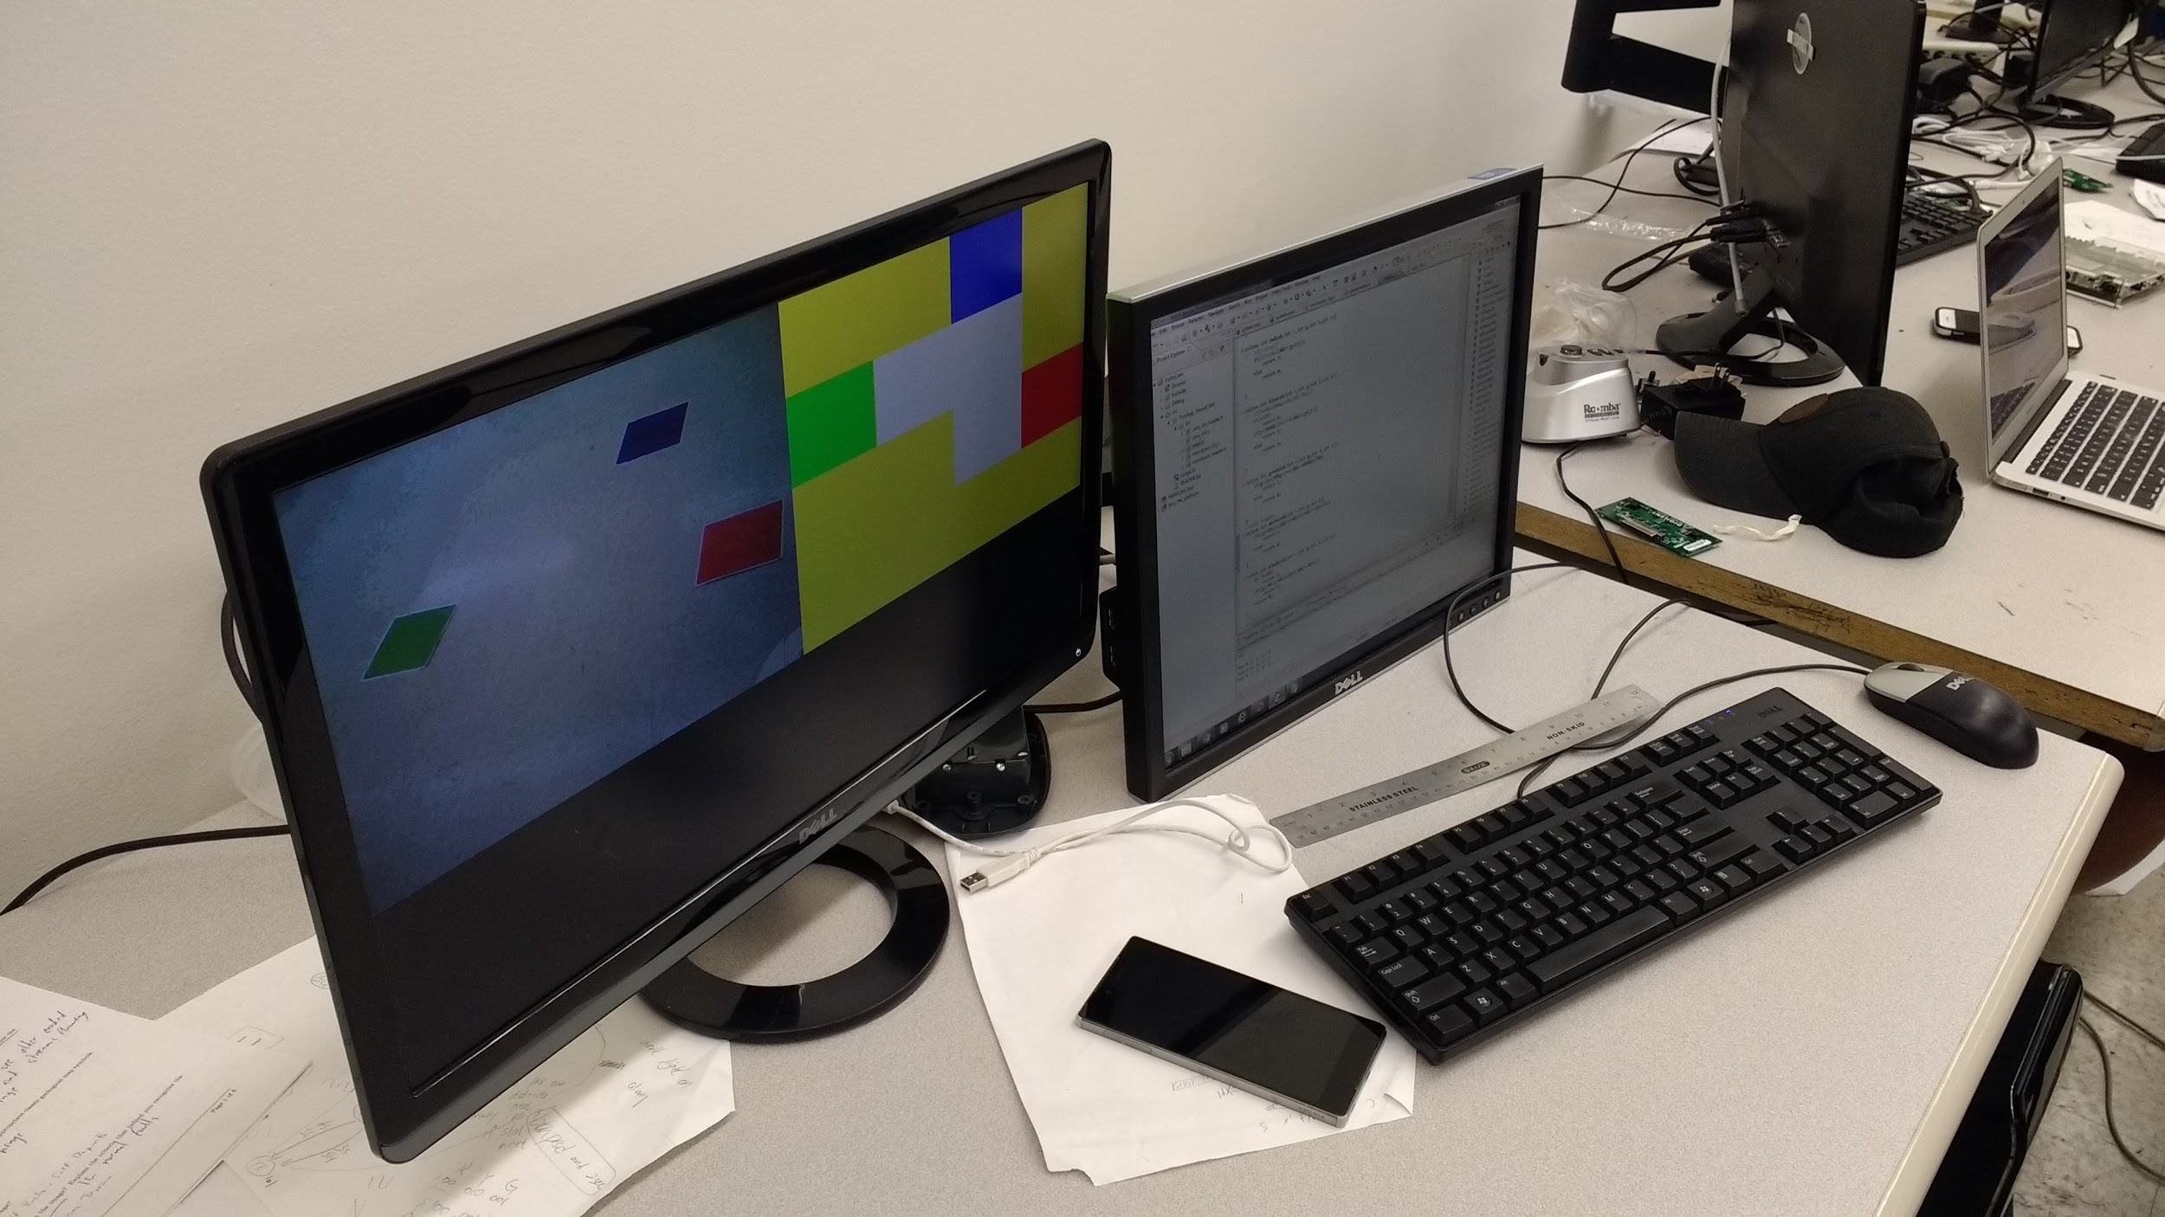
Demo (screen)

Slide 16
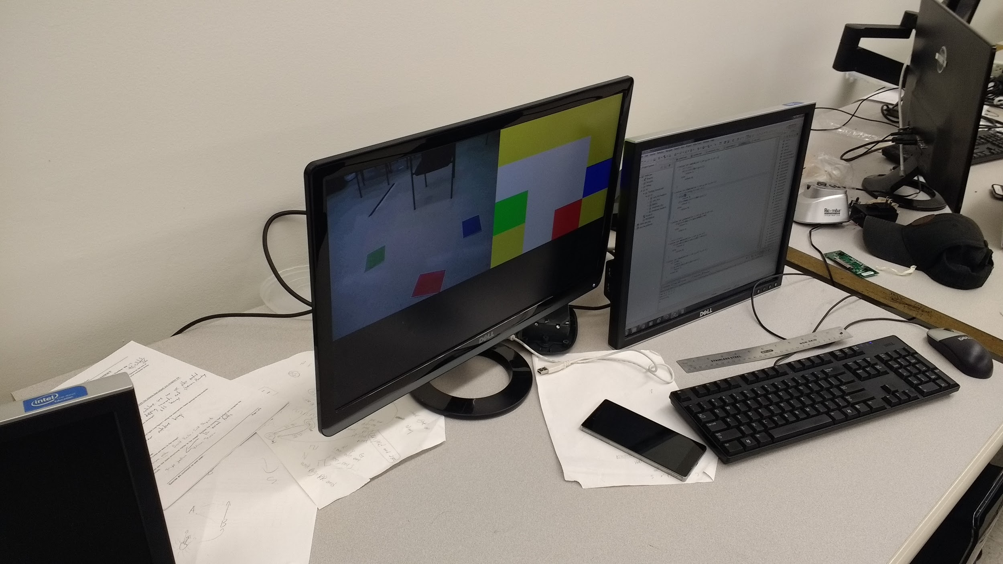
Demo (screen)

